Slide 1
CIT 21300 Final Presentation Overview Created By Jagger Collins

Slide 2
Phase 1: Requirement Gathering
Simulated shareholder/ sponsor meetings to discuss the project’s requirements.
Identified candidate use cases, actors, and classes.

Slide 3
Phase 1: Questions for Shareholders
Membership Details
What information is required to sign up for a new membership (e.g., ID, verification, address proof)?
A: SOME FORM OF IDENTIFICATION
Media Checkout
How many items can a member check out at one time?
A: Up to 10 items every 2 weeks
Fine and Payments
How are fines calculated (per day, per week, etc.)?
A: Fines are billed to your account for each item not returned, 5 books late would be 5 separate fines.
Meeting Room Reservations
Is there a limit to the number of reservations a patron can make within a given timeframe?
A: A patron can only reserve one meeting room per week.

Slide 4
Phase 1: Candidate Use Cases, Actors, and Classes
Use Cases:. Sign Up for Membership, Check Out Media, Reserve Media, Reserve Meeting Room, View Account Details, Pay Fine, Pay Fine, Notify Users, View Transactions
Actors: Library Member, Library Staff, Payment Processor (PayPal), Backend Databases.
Classes: Membership, MediaItem, Reservation, Fine, MeetingRoom, Transaction.

Slide 5
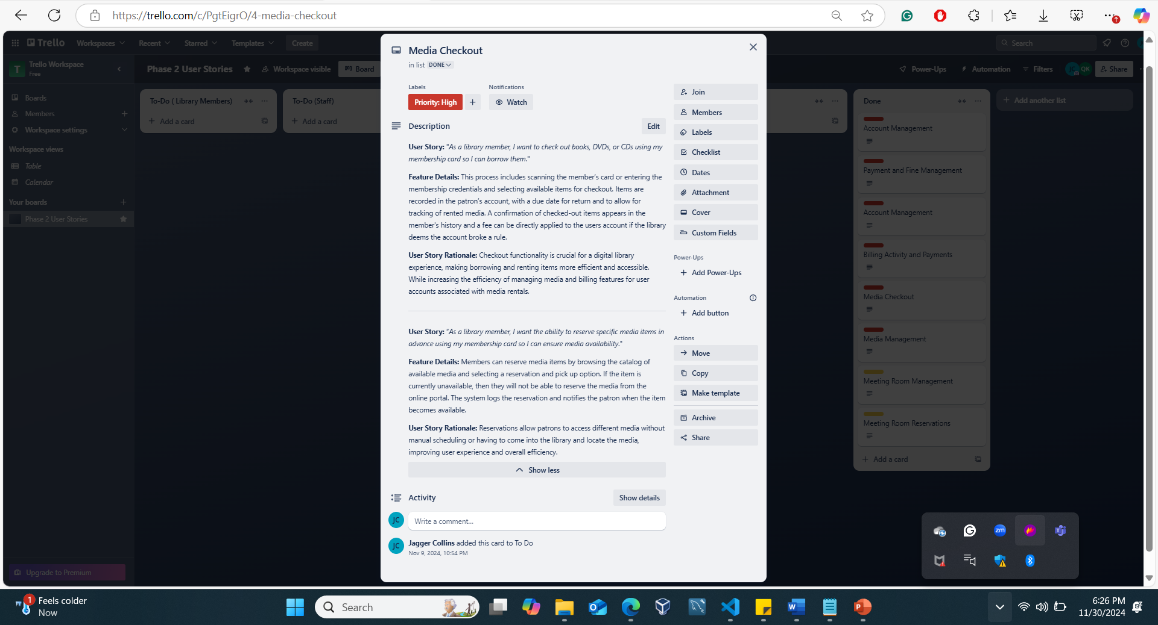
Phase 2: Trello Board and Use Stories

Slide 6
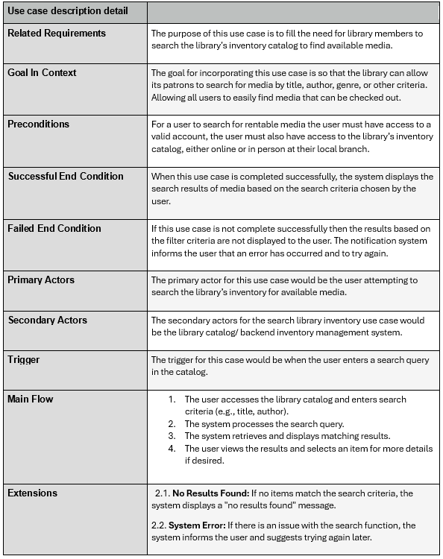
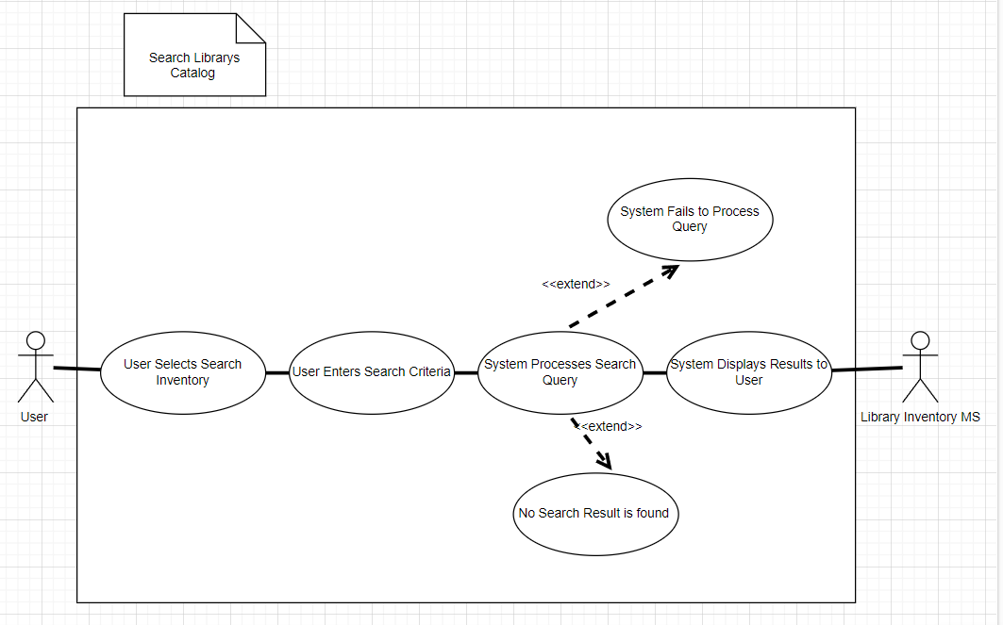
Phase 3: Use Case Diagrams
Search Library Catalog Use Case Description
Search Library Catalog Use Case Diagram

Slide 7
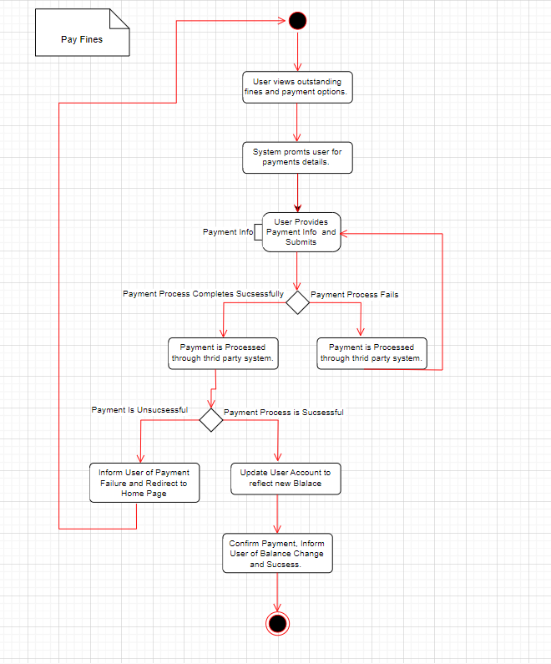
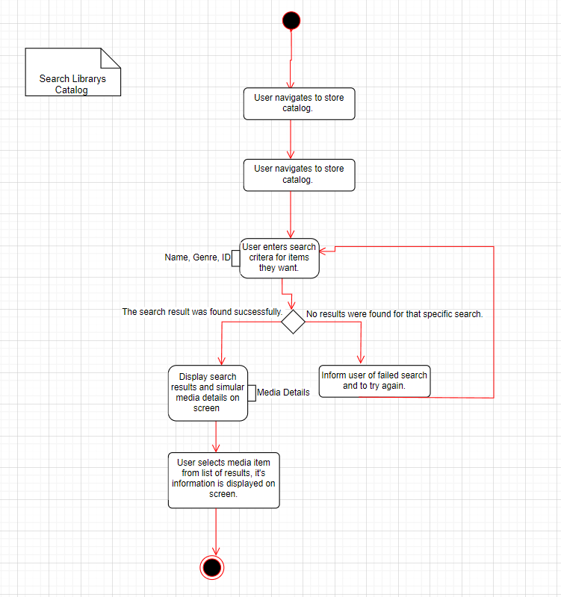
Phase 3: Activity Diagrams
Search Library Catalog Use Case Description
Search Library Catalog Diagram

Slide 8
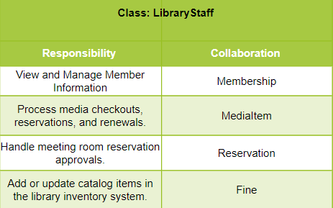
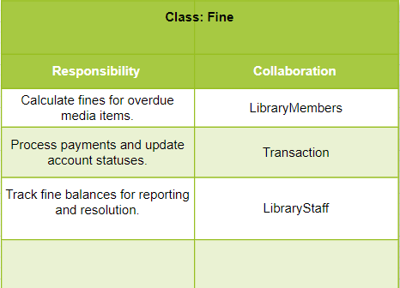
Phase 4: CRC Tables
LibraryStaff CRC Table
Fine CRC TABLE

Slide 9
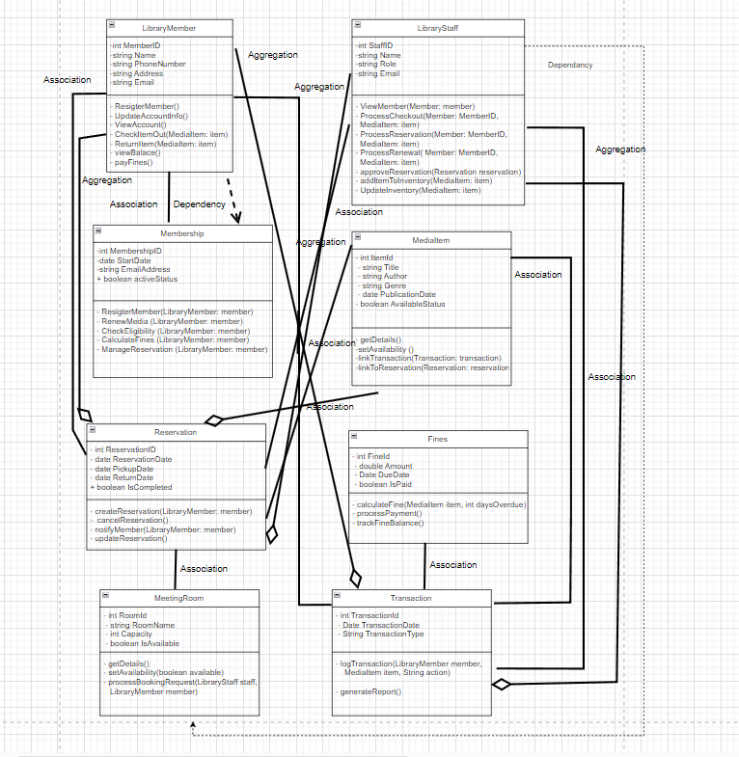
Phase 4: Plainstown Library Class Diagram

Slide 10
Phase 4: Sequence Diagrams
Search Library Catalog Use Case Description
Search Library Catalog Diagram

Slide 11
Thank You For Watching

